Slide 1


Cloud for AI
Course 6: Production-Level Code
Filotas Theodosiou

Slide 2
What are we going talk about today?

Slide 3
What are we going talk about today?
Writing code ML code
Notes:
Ok today we have another practical course.
How to write good ML code.
In my experience go ML code is extremely important to save time and enhance collaboration
It helps to read and reproduce!
I am going talk about some basic principles

Slide 4
The significance of production-level code.
What do we mean with production level code?
Software that is robust, efficient and ready for deployment in a real-world environment.
Notes:
Ok what do we mean with production level code?
We want robust, efficient code that is ready to run in an application somewhere.

Slide 5
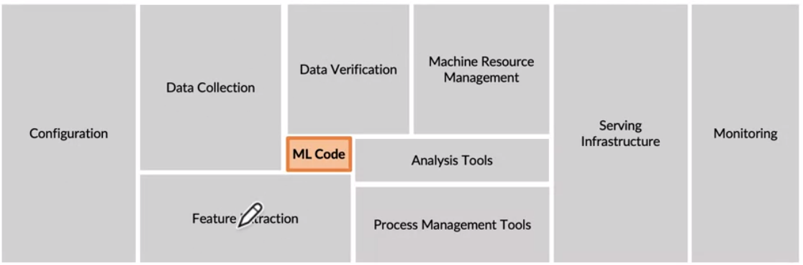
The significance of production-level code.
What do we mean with production level code?
Software that is robust, efficient and ready for deployment in a real-world environment.
Criteria for production level code:
Scalability: handling an increasing amount of work smoothly
Maintainability: Easy to understand and modify
Reliability: Operates as expected under varying conditions
Efficiency: Does not waste valuable resources
Remember: Your code needs to effectively communicate with the entire ML system
Notes:
Remember our ML code is only a part of a bigger application. So its parts need to communicate effectively with the rest of the system.
For that reason we need
Scalable code, meaning as we add extra lines the code will be able to scale easily
Maintainability: We can easily find bugs and debug
Reliability, we know it works and we trust it to increase our capacity
Efficiency, code is efficient, not a lot of loops, no useuless cpus etc

Slide 6
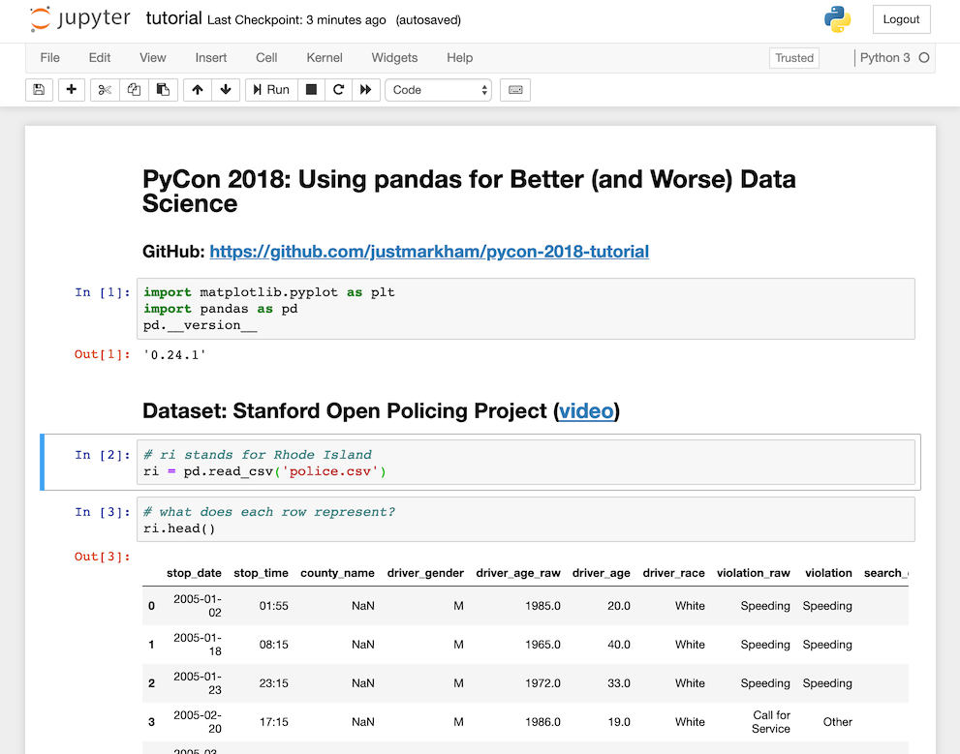
Production level code and Notebooks
What is the issue with Jupyter Notebooks?
Notebooks are great for development
Interactive
Stateful (don't have to re-run code)
Allows for output visualization
Notes:
Notebooks are for a Data Scientist what excel is for Data Analysts.
Its their most basic tool.
I personally love them. They are interactive, you can test new things, you can see what works and what know, you can debug
You can run only specific chunks, that means they are statefull and so on.
Ah you can also visualize the output of your model, draw graphs, due some exploratory analysis and so on.
All in all, a great tool!

Slide 7
Production level code and Notebooks
What is the issue with Jupyter Notebooks?
Notebooks are great for development
Interactive
Stateful (don't have to re-run code)
Allows for output visualization
For applications though, we need scripts that are:
Stateless: explicitly pass variables to functions instead of keeping them in global memory
Linear: Execute code from start to finish
Testing-friendly: Easy to compose and run
Notes:
However when it comes to real world applications we need something more.
We need stateless scripts, meaning you explicitly pass our variables to functions and not keep them in memory as with notebooks
We need linear execution, starting from the start to the end. This way we ensure reprucibility
With testing friendly I mean well written documents that we can explore

Slide 8
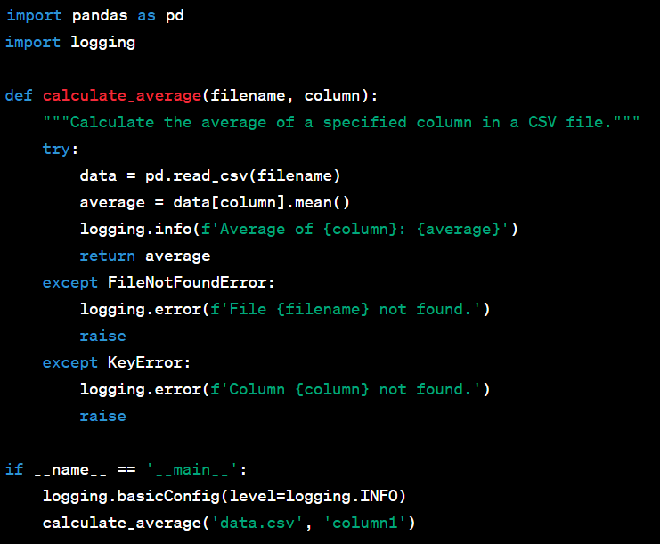
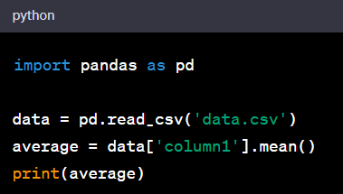
Some examples
You are tasked with creating a simple script to read a CSV file and calculate the average of a column
Research Environment (Notebooks)
Just solve the task at hand!
If you encounter error, find ad-hoc solution
No error handling, logging no scalability
Production Environment (Script)
Clear structure, error handling, logging
Robust, scalable and maintainable code
Notes:
Ok lets look at took examples now!
What happenes on a research environment and what we want on production!

Slide 9
Key Concepts of Production-Level Code
Structured project repositories
Scalable and reproducible code
Clean code principles
Logging and Error Handling
Documentation and Commenting
Code Formatting and Styling
Writing good tests
Pipelines in ML projects
https://madewithml.com/
Notes:
Ok these are some of the concepts we are going to talk about today.
I have gathered them from the madewithml.com.
A very good resource if you go on MLOps
Read them and explain what we will be doing at each part

Slide 10
Key Concepts of Production-Level Code
Structured project repositories
Scalable and reproducible code
Clean code principles
Logging and Error Handling
Documentation and Commenting
Code Formatting and Styling
Writing good tests
Pipelines in ML projects
https://madewithml.com/
Notes:
Ok lets start with Structured project repositories.
I have talked about it a bit in the start of our course but lets see what I mean

Slide 11

Setup your Repository 1.
Readme:
Always a good idea to start organizing your scripts with Readme.md file
Its where you organize all the instructions necessary to walkthrough the codebase
Keep information on how to set-up environment, run scripts etc.
https://madewithml.com/courses/mlops/scripting/
Notes:
Lets talk about the Readme.
First of all, when looking for a job, there is nothing more important than your github account. Try to have it clean
On your projects always have a good Readme.
When someones goes to check your work he wants something to navigate.Some directions.
What is the project about, where do I find what I am looking for.
Try to keep information up-to-date. Not a lot of words but specific and precise instructions on where to focus etc!

Slide 12
Setup your Repository 1.
Readme:
Always a good idea to start organizing your scripts with Readme.md file
Its where you organize all the instructions necessary to walkthrough the codebase
Keep information on how to set-up environment, run scripts etc.
https://madewithml.com/courses/mlops/scripting/
What to include:
Project title
Description
Installation guidelines
Examples
Contributions
etc
Notes:
Read the what to include!

Slide 13
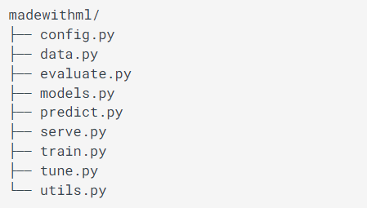
Setup your Repository 2.
Scripts: Move your code from notebooks to scripts
Create different files and directories for the project
Choose names that relate to a specific workload
A usual structure:
Notes:
Next we have scripts. As we said we move from our notebooks to scripts to deploy in production.
Its a necessity to have a good structured and organized structured for your scripts
Users should be able to navigate easily and find what they are looking for
For example if I want the training script I need to easily navigate and find it!
Use names that refer to what each script contains.
For functions that are used on multiple files use a utils.py to include them. I find this practise very helpful!

Slide 14
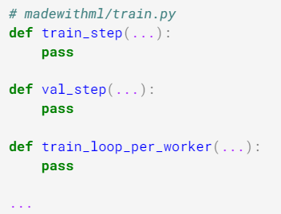
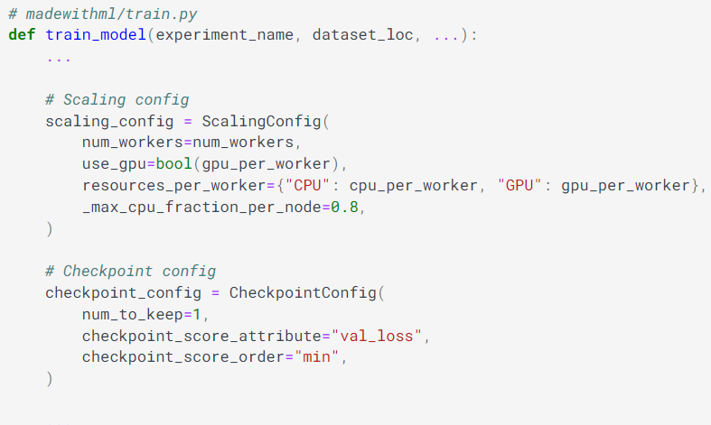
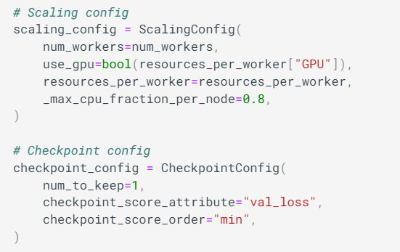
Setup your Repository 3.
Once you have your structured set => Move code from notebooks to scripts
Tip 1:
Convert the code of each notebook cell into a function
Tip 2:
Wrap small functions around more abstract to easily execute them during workload
(Pipelines!!)
Notes:
Ok, when we have set our structure for the repo its time to move our code from the notebook.
We refactor our code and organize it in small functions with each having a specific modularity.
Remember more functions the better. We want as much free code as possible
Then what we do is we wrap smaller functions into bigger functions
This way we ensure maintainability and reliability. We can easily track back for our errors and improve.
Talk a bit on the examples !

Slide 15
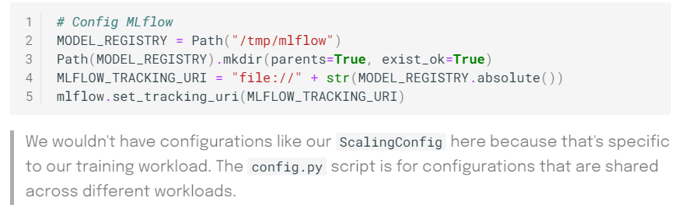
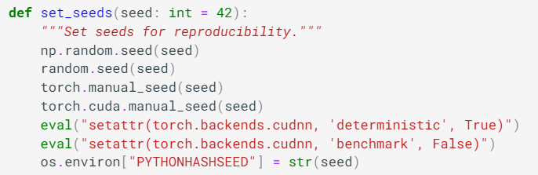
Setup your Repository 4.
Config files.
This file includes all of the setups and configurations for all/most workloads
Utilities files.
A script to include components that will be reused across scripts.
You can avoid circular dependency conflicts (two scripts call a function from one another)
Notes:
Ok, two important files they ask for any project.
They utils and the config file
The config file is where we setp our configuration so we ensure consistency across all our workloads.
For example we use it for common settings like model registry paths, URLs, directories etc
These should be shared across the entire application
Next we have the utilities files.
It houses shared functions such as the set_seeds which is used for reproducing our experiments
We us utility scripts to prevent circular dependencies between different files. For example importitng a functions from one file that imports another from the same file!
With the utils.py we facilitate code reuse and we maintain a single point for our shared functions.
If it gets too big we have a utils for each module. For training, testing etc.

Slide 16
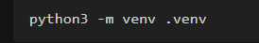


Create Virtual Environments.
An isolated workspace to manage dependencies and versions.
Dependency management: Different projects require different libraries or versions
Reproducibility: Everyone running the applications uses the same libraries
Isolation: Libraries and tools from one project do not affect the others
venv (for Python 3) allows you to manage separate package installations
When you switch projects you create a new virtual environment:
Location
And then you can activate it:
Then you install your packages:

Slide 17
Key Concepts of Production-Level Code
Structured project repositories
Scalable and reproducible code
Clean code principles
Logging and Error Handling
Documentation and Commenting
Code Formatting and Styling
Writing good tests
Pipelines in ML projects
https://madewithml.com/
Notes:
Next we have scalable and reproducible code.

Slide 18
Scalable Code
Definition:
Code that can handle an increasing amount of work by adding resources
Assume that new data is coming in every week
At some point the efficiency of your code will start decreasing
You update your hardware (either horizontally or vertically)
You update your code to match the hardware update!
Why not have scalable code in the first place?
Notes:
Oke lets first define what we mean with scalable code.
We scalable code we refer to code designed to efficiently manage increased workload by leveraging additional resources
Scalability addresses the challenge of growing data volumes and extra computational demands!
Lets look at an example
Say new data is arriving every weekly. At some point you will reach a point that your code will start running slow
We might even hit some bottleneceks
What we will need is we will update our hardware. Get extra memory, GPUs etc
If we have not account for scalability we would spend some time adjusting our code for the new hardware
So the question is: why dont we do that in the first place? Why dont we build scalable code from the beginning?
It would save us valuable time!

Slide 19
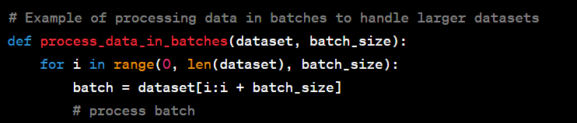
Example of Scalable code.
Load data as data size increases!
Notes:
This is a small example of scalable code.
When we know that our dataset will grow large we need to make sure we are able to load it.
So we load and preprocess in batches!
A very common approach in practise.
I am sure you will do a project someday where you will hve to load a big dataset that wont fit in the RAM of your computer. When that day comes, use functions like this. Load, work in batches and save again in batches!
If possible add some parallization too!

Slide 20
Reproducible Code
Definition:
Code that yields the same results across different runs and environments.
Important in ensuring consistency and validity
Assume you train a Neural Network in your Laptop
Your manager runs the same code and gets completely different results!
Why?
Neural Network training is prone to multiple things like weight initialization.
How?
Dockerize (next lecture)
Set seeds!!! (very important)
Notes:
Ok, next we have reproducible code. What do we mean by that?
With reproducible I refer to code that will yieldthe same results across different environments.
This is very important for a number of reasons.
For example our manager our colleagues need to reproduce our results
Or we want consistency between our clients etc.
Take for example this. You train a network, you get perfect results. When I re-run your code I get completely different results and thus, worse accuracy.
I would then challenge your claims that your accuracy is 99%.
Why does that happen?
Most ML models are prone to multiple things. for example weight initialization, operations type (floats64 vs floats32 etc). Its very important to ensure
So how do we achieve reproducibility: Just describe the content there a bit

Slide 21
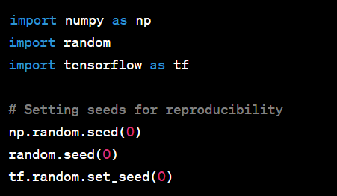
Example of Reproducible code
Set all seeds to fixed numbers to ensure consistency
Notes:
Thats an example of reproducible code. When we begin we set every package that uses random number generators to a specific seed number.
We usually do that on functions on utils but config would work as well!

Slide 22
Importance of Scalable & Reproducible Code
In academic code:
Focus is often on proving concepts under controlled conditions (a fixed experiment) to get results.
We do not care so much to scale or reproduce the experiment
In production environment:
Scalability:
Ensures the system can handle real-world data volumes and user loads
Facilitates resource optimization and cost-effectiveness
Reproducibility:
Guarantees consistent model behavior. Crucial for real-world applications
Aids in debugging and iterative development
Notes:
So why do we care about these things so much?
Read for academic
In production we have more things to worry about!

Slide 23
Key Concepts of Production-Level Code
Structured project repositories
Scalable and reproducible code
Clean code principles
Logging and Error Handling
Documentation and Commenting
Code Formatting and Styling
Writing good tests
Pipelines in ML projects
https://madewithml.com/
Notes:
Oke, next we are going to talk about clean code principles. What makes good clean code!

Slide 24
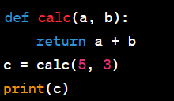
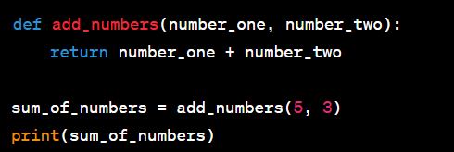
Clean Code Principles
Write code that is easy to read, understand and maintain by others.
It helps in reducing bugs, easing the debugging process and promoting effective collaboration
Principles:
Readability
Simplicity
Clarity
Consistency
Good usage of Data Structures
Messy code
Clean code
Notes:
Thats a very important topic. Its something that will come a lot on job interviews so you have to be prepared here!
We need to write clean code!
Our code will be read, adjusted by others so people need to understand what you write.
How can you debug if you dont understand what you are writing? How are you going to assist your colleague??
Even worse, imagine going back on a project you worked a month ago. Will you be able to understand what you were talking about?
Your code needs to be readable and as simple as it gets. Simple code is better than a good model! Trust me
It should be clear and consistent across the entire document
Most importanly it should be efficient. You should realy dosome good usage of your Data Structures. This is something you will be tasked with on any interview you go out there!
Check these two examples and you tell me the differences!

Slide 25


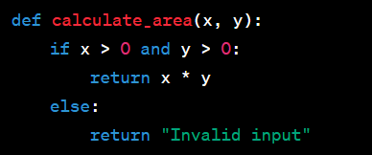
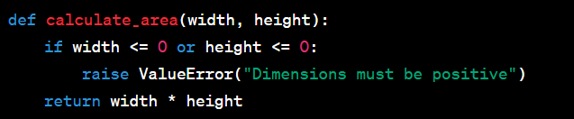
Readability & Simplicity
Choose meaningful variable and function names
Keep functions and classes small, focused on a single task!
Poor readability
Good readability
Avoid unnecessary complexity
Leveraging simplicity in code structured and logic
Complex Code
Simplified Code
Notes:
Just read the examples here

Slide 26
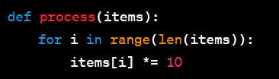
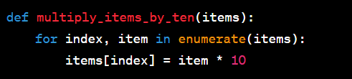
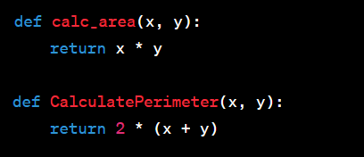
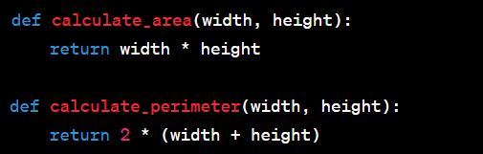
Clarity & Consistency
Writing code that explicitly states its purpose
Avoid clever or tricky code that is hard to follow
Tricky Code
Cleaner code
Stick to a consistent coding style and naming conventions
Follow the established patterns and practises of the codebase
Inconsistent code
Consistent Code
Notes:
Read the examples

Slide 27
Efficient use of Data Structures
A de-facto question in every Data Science & ML job!
The effective use of data structures facilitates access and modification of data
=> crucial for algorithmic efficiency.
Focus for MLOps is on arrays, lists and dictionaries.
Will not go into details (Happy to share resources)
Arrays: Suitable for storing data that does not change in size
Lists: Suitable for storing collections of data that may change in size
Dictionaries: Suitable for fast lookups and retrieving data in unordered collection
Understand the time complexity of operations in these data structures
Choose the right data structure based on your task at hand
Notes:
Except for being very common questions in data science and ML interviews, data structures are very important for algorithmic efficiency.
This impacts model performance and then resource utilization. So we need to be very careful how we use them.
For MLOps the main structures we are going to work with are arrays, lists and dictionaries. I wont go in a data structure course but I am happy to give details!!
then just read

Slide 28
Key Concepts of Production-Level Code
Structured project repositories
Scalable and reproducible code
Clean code principles
Logging and Error Handling
Documentation and Commenting
Code Formatting and Styling
Writing good tests
Pipelines in ML projects
https://madewithml.com/
Notes:
Any questions so far? Good, now lets move to error handling! Another very important concept.

Slide 29
Intuition of Logging
What is Logging?
Logging is the process of tracking and recording key events that occur in our applications
For inspection
For debugging
Why logging?
More powerful than print() statements
They send information to specific locations for every user
They use custom formatting, shared interfaces etc
A key component of every ML application.
Notes:
Examples of logging:
Training of a NN
Bugs!
Weird results
Used for debugging because its more powerful than simply printing
Also we can save these logs on specific folders, chose the formatting we want to help us in our application, and send them to anyone we want

Slide 30
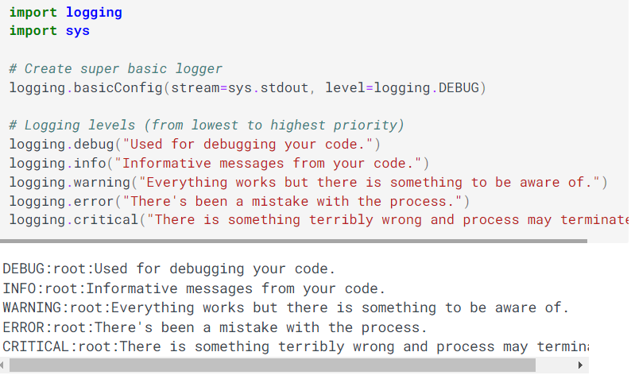
Levels of Logging
There are different levels of logging based on the criticality and the priority.
lowest priority to print
Where to send error
Debug has the lowest priority
Critical has the highest
Notes:
Say different levels and read them!

Slide 31
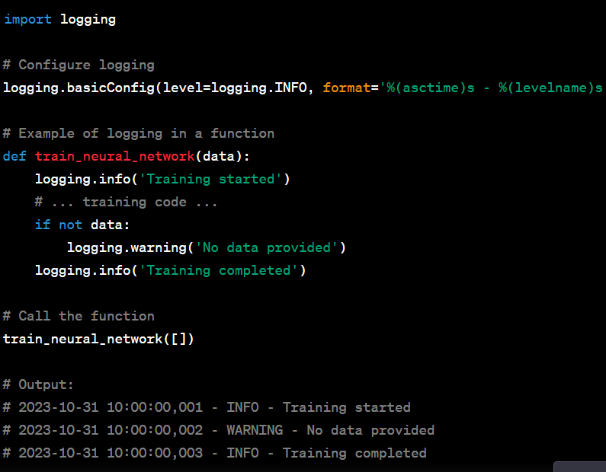
When to use Logging
Print progress on
Training a NN
Tracking hyperparameters
Detecting logging anomalies
etc…
In short:
We replace print() with logginst statements
Notes:
Thats an example of using logging. So instead of simply printing, we want to send our logs to a file somewhere to keep our updates.
Read examples when you use and show the code to the example
The warning on no data

Slide 32

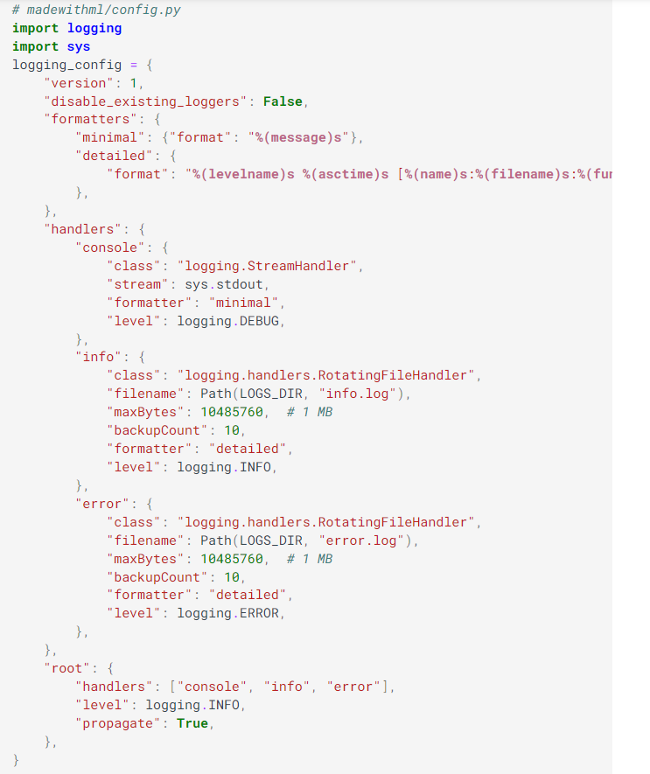
How to set-up Logging
First set-up the location where the logs will be saved
Next configure the Logger for the application
Define two Formatters (format and style of logs) for minimal and detailed
Define the different Handlers (details about location of where to send logs)
console: Sends logs to the stdout for message over Debug level
info: Send log messaged to logs/info.logs for messages about info
error: Send log messages to logs/error.log for messages over error
Attach different Handlers to the Logger
Notes:
Walk through the examples
We define the logger on the config.py file
Formaters:
One for small messages
One for big detailed messages!
Handlers:
Where to send the logs
Each type of log can be send in different locations
Read it from the notes

Slide 33
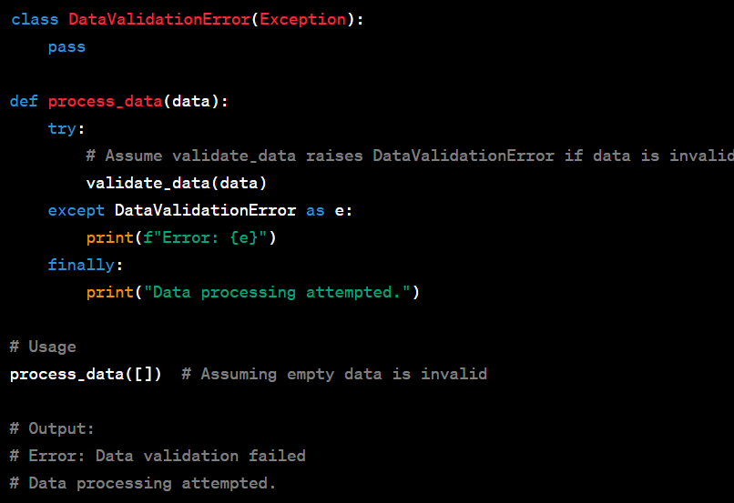
Implementing Error-Handling
Common error handling techniques: try & except
Important Tip: Utilize them for raising specific error messages!
Given this message we know where the model failed!!
Notes:
Now lets move to error handling. How to better understand the error on our applications.
Instead of relying on errors of our packages (each imported package has specific error messages) we can define our own!
How? with try-expects!
I believe you have seen these before.
Its very important to use them on snippets you believe an error is probable. Then you give your own message so you get an idea what is going on.

Slide 34
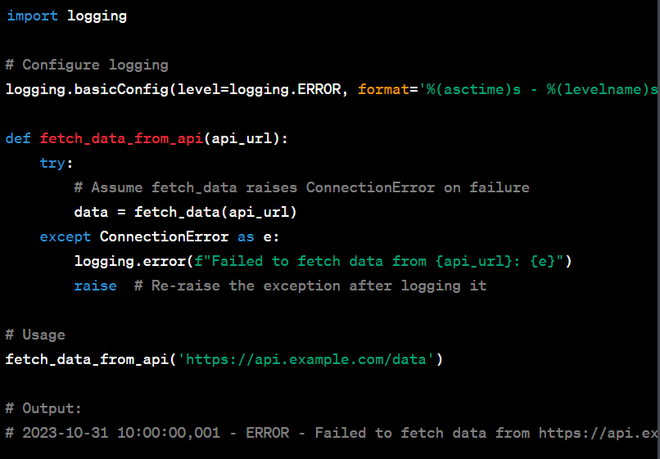
Combining Logging with Error-Handling
Why Logging & Error-Handling
Ensures Robustness
Catching and handling exceptions to prevent system crashes
Enhances Traceability
Centralized logging for monitoring system behavior over time => better insights & post-analysis
Facilitates Debugging
Reproduce issues with detailed log records to diagnose and fix issues
Notes:
So to put everything together!
We use logging & error-handling to:
Ensure robustness of our experiment. We now how to handle everything the system might come across!
Enhance the traceability and get insights for our experiments
Assist us in debugging. We can more easily track where the bug is coming from. and since we have good functions we can always go and fix it
Here is an example of how to combine error handling and logging!

Slide 35
Key Concepts of Production-Level Code
Structured project repositories
Scalable and reproducible code
Clean code principles
Logging and Error Handling
Documentation and Commenting
Code Formatting and Styling
Writing good tests
Pipelines in ML projects
https://madewithml.com/
Notes:
Good, next we have documentation and commenting.
Another extremely important concept!

Slide 36
Intuition of Documentation
When you review your code after two years without comments, remember me!
Improve the quality of your codebase & make it easier for others.
After some days you will forget what your code was like!!
Most important components
docstrings: Descriptions for functions and classes to describe utilities
comments: short descriptions as to why a piece of code exists
typing: Specification of a functions input/output.
docs: Rendered webpage summarizing all functions, classes, workflows
Notes:
Ok back to the example we talked about before.
Imagine going back to a project you build 1 year ago to take one function you need to use again.
How would you be able to understand how the functions works?
Or how would your colleague understand your code!
In my eyes, documentation is the mosti important concept in ML coding!
Describe each documentation principle

Slide 37


Typing
Allows to be as explicit as possible with your code.
Explicitly defining the types of a functions inputs and outputs allows reproducibility and scalability
Notes:
Lets start with typings!
Typings are very important. They ensure you will always get your desired outcome.
They assist with both error handling and reproducibility

Slide 38
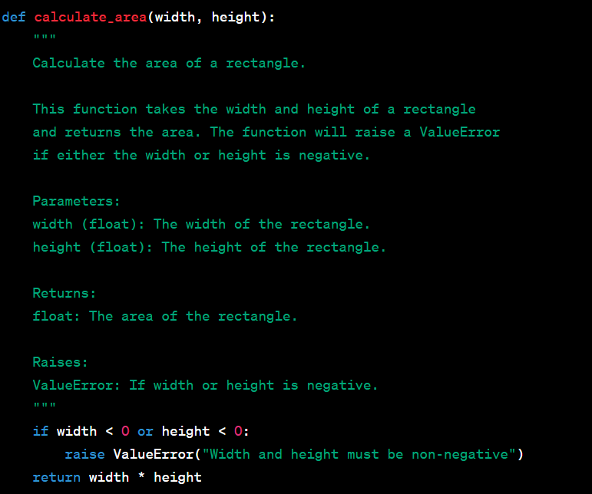
Docstrings
Describes the overall utility, the input and the output of the function
There are tools (extension of VIS code) that allow for automatic documentation generation
Sphinx -> my personal favourite!
Doxygen
pydoc
Unpopular tip:
Use Copilot or chatGPT, they do surprisingly well)
Notes:
Next we have docstrings
Just talk about them

Slide 39
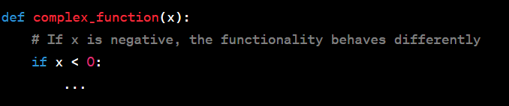
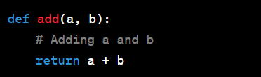
Commenting
Extremely important for good quality of code!
Assist in explaining complex code, stating intentions, marking todos and noting external dependencies
What to do:
Write clear concise comments that explain the why, not the how (code tells the how!!!)
Comments on sections where functionality might not be obvious (otherwise is chunk!!!)
Update comments when code is changed
What not to do:
Avoid commenting obvious code
Avoid redundant or outdated comments
Avoid large blocks of comments
Good commenting
Bad commenting
Notes:
commenting is the most important part for me.
I have always been arguing with colleague with how bad they do their commenting and that I cannot work with that!
Lets give some tips!

Slide 40
Key Concepts of Production-Level Code
Structured project repositories
Scalable and reproducible code
Clean code principles
Logging and Error Handling
Documentation and Commenting
Code Formatting and Styling
Writing good tests
Pipelines in ML projects
https://madewithml.com/
Notes:
Ok, next we have Code Formatting and Styling! Not so important but alway make up for coding practises.

Slide 41
Intuition for Code Styling
When you write code its almost never the last time you see it or the last time you edit it.
You need to explain what is going on (documentation & commenting)
Make it easy to read
How to make it easier to read?
Follow consistent style and formatting conventions (PEP8 is the most widely applied)
The most important aspects
Collaboration: teams write in the same coding style
Consistency: Same patterns across all scripts
Automation: Code is styled effortless after initial configuration
Notes:
One of the nicest lines from Van Rossum, the creator of Python. We read code way more than we right!
So lets make it pretty!!
Lets help ourselves save some future time
Read some of the aspects

Slide 42
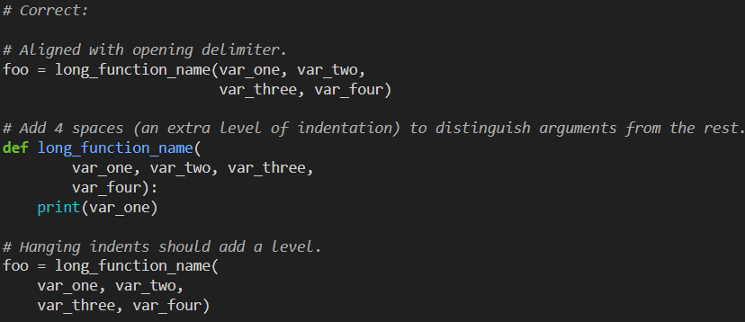
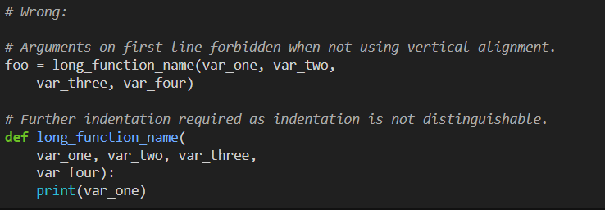
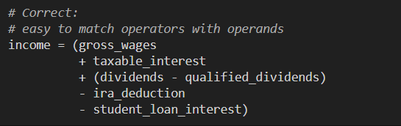
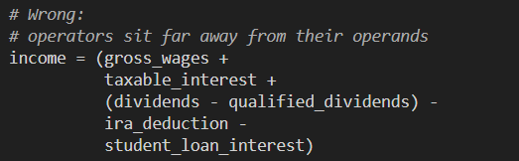
Examples
https://peps.python.org/pep-0008/
Indentation
Line breaks
Notes:
read examples

Slide 43
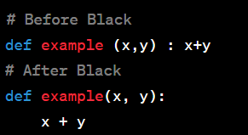
Tools for Formating!
Black:
An automatic code formatter that makes code conform to the default PEP 8 style
Easy to install and set-up
Changes applied automatically after saving
Flake8:
A tool that automatically check your code against coding styles (PEP 8), checks for syntax errors and complex or error-prone lines
Easy to install and set-up
Returns warnings!
Combine the two to maximize your code efficiency
Notes:
Explain the two modules
Say you can easily install and use them on your Visual Studio Code.
They work automatically and you dont need to do anything.
For example Black changes the style every time you save!

Slide 44
Key Concepts of Production-Level Code
Structured project repositories
Scalable and reproducible code
Clean code principles
Logging and Error Handling
Documentation and Commenting
Code Formatting and Styling
Writing good tests
Pipelines in ML projects
https://madewithml.com/
Notes:
Ok, next we have tests.

Slide 45
Why tests are important?
Tests are a way to ensure that something works as intended.
We verify that the following function as they should!
Code
Data
Models
They are important because:
We discover sources of error early
We decrease downstream costs and wasted time later
Are executed automatically every time there are changes to the system
Notes:
Before we through our model in production we need to make sure that everything works as we planned.
We need to test different things!
We need to test our code for bugs, edge cases etc
We need to check that our data is ok, no outliers, no nans etc
We need to check that our model behaves as it should even on edge cases!
We are test important
We find errors very early and save important time
We can save so much time and costs by catching the errors before they escalate!
Once we design them, they will run automatically so we dont need to worry about them!

Slide 46
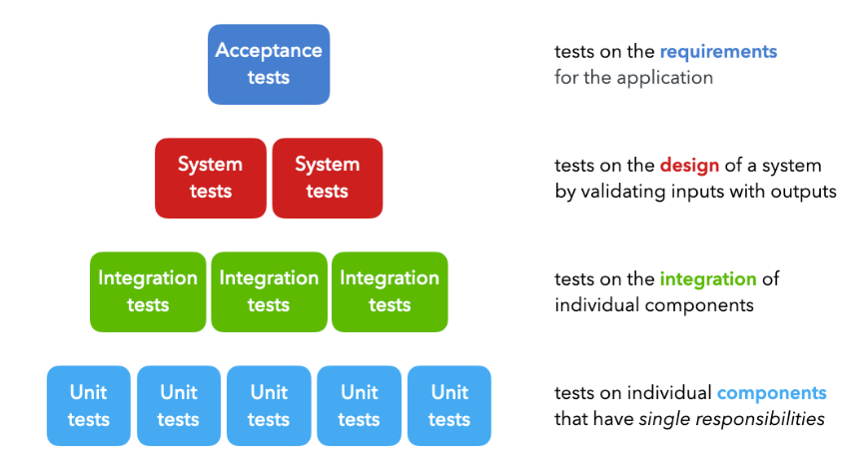
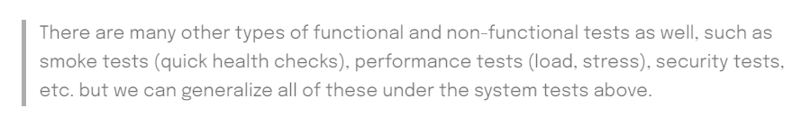
Types of tests
There are 4 major types of tests implemented during the development cycle:
Unit Tests: Evaluations conducted on singular components each possessing a distinct responsibility (e.g., functions designated for filtering a list).
Integration Tests: Examinations performed on the collective functionality of individual components (e.g., data preprocessing).
System Tests: Evaluations directed at the system's design to ascertain expected outputs from given inputs (e.g., training, inference).
Acceptance Tests: Assessments conducted to confirm that specified requirements have been fulfilled.
Notes:
Ok, we have 4 different important types of tests!
Unit tests: they are focused on individual components with single responsibilities. they are useful for validating small pieces of code like functions or methods
Integration tests: ensure different components work together correctly. They test interfaces between data flows for example the full data preprocessing pipeline)
Systems Tests: They are comprehensive evelatuions of the entire systems functionality. They test if the system meets the requirements end-to-end.
Acceptance Tests: the finall tells. COnfirms that the system fullfils business requirements. It validates if the system is read for deployment

Slide 47
How should we test?
The framework to use when composing test is the Arrange Act Assert methodology
Arrange: set up the different inputs to test on
Act: apply the inputs on the component we want to test
Assert: confirm that we received the expected output
In Python, there are many tools, such as unittest, pytest etc that offer easy implementation of the above framework.
Due to their build-in functionalities (filters, parametrization) they work very good in scale
Notes:
To write good tests we use the arrange-act-assert methodology.
Describe it
There are many tools in python that helps us work with these things like unittest and pytests. They implement they above with ease!
They also offer many build-in functionalities so they work very good at scale!

Slide 48
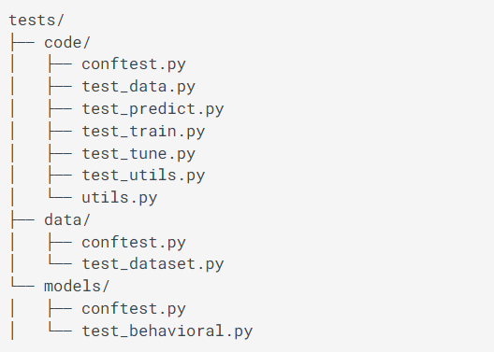
Set up testing
Create a new folder “tests” and have a subfolder for each component.
Then give tests names as follow “test_*.py”
pytest by default searches for the test directory and scripts with “test_*.py”
Notes:
How to set-up testing!
(Just read and explain here)

Slide 49

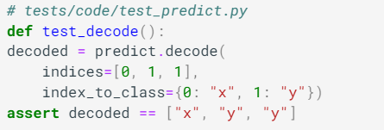
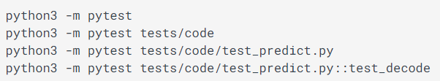
Test example
Assume we have a function that decodes a list of indices into their class using a dictionary mapping
To test this function we can use assert statements to map inputs with their expected output.
Assert should return True!
Once we have developed tests for all functions we use pytest to run them!
(Note, we can also run specific tests only)
See the results on the terminal
Notes:
Ok now lets view a simple example!

Slide 50
Extra important concepts
Parametrization
Fixtures
Markers
Coverage
Exclusions
Refer to link for extra details and examples!
Notes:
Some other important concepts for testings regard the following.
I suggest you going to this link to review them in case you have to write tests!

Slide 51
Data Testing
Except from the functions that interact with our data we need to test the validity of the data itself!
Why is it important to test the quality of our data:
Garbage in - Garbage out: Poor data quality leads to incorrect model predictions
Bugs: Data coming from streaming sensors or other format is prone to mistakes leading to bugs
Missing values
Incorrect column names
Different data types
We are going to use the great_expectations library to ensure our data looks as it should.
Notes:
Ok now we go to Data Testing.
Except for our code we also need to test our data!
Why? (Read the bullet points)
Thankfully we have libraries that do this for us. We are going to use the great_expectations library to test the validity our data.

Slide 52
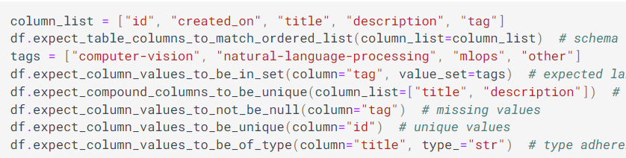
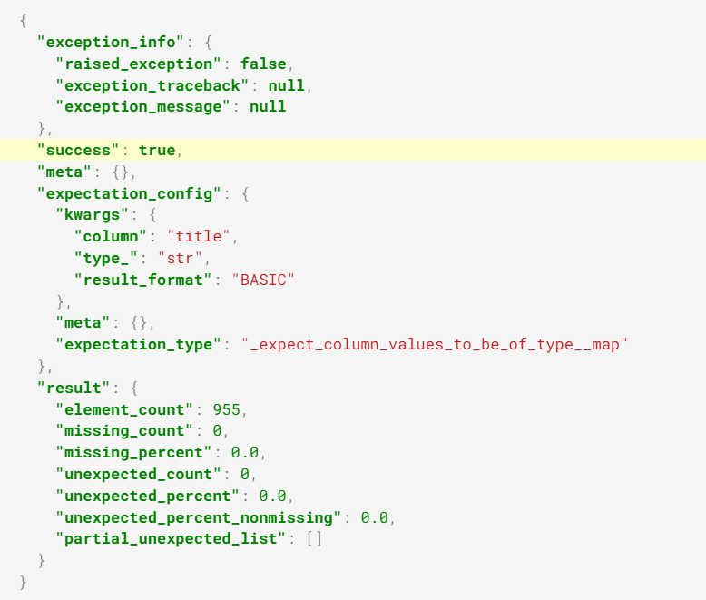
Data testing example
Create expectations for what your data should look like.
Think about the entire dataset
Think about all the features (columns)
For each expectation get_expectations creates an output with details if the test is passed or failed
For example the
This would return False
Notes:
First we create some guidelines on how what our data should like like!
We need to think how the dataset should be, we need to think all the features, the types, the columns etc!
Then for each of the expectations we create a test that runs automatically as we get new data!

Slide 53
Model Testing
Test ML models during training, evaluation, inference and deployment.
Its important to write test iteratively while developing training pipelines
Catch errors quickly
Save time and compute (GPUs are not free ;) )
Unlike traditional software, ML models might run without throwing exceptions/errors
For example training with NaNs will continue and results will be NaNs
However they might still produce incorrect systems.
Note: This type of Model testing is different than when we are evaluating the accuracy of the model
Notes:
Ok, finally we have to test our Models!
We need to be certain that they work each unique stage! We have training, we have evaluation, inference and deployment!
These tests should be written together while we develop our code. This helps in many things
(Read what it helps us with)

Slide 54
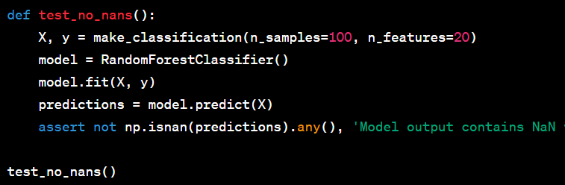
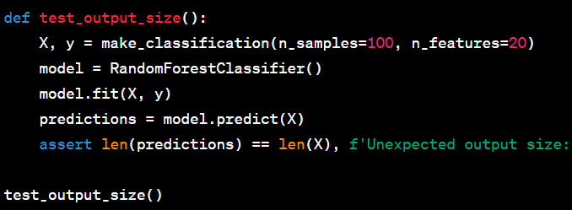
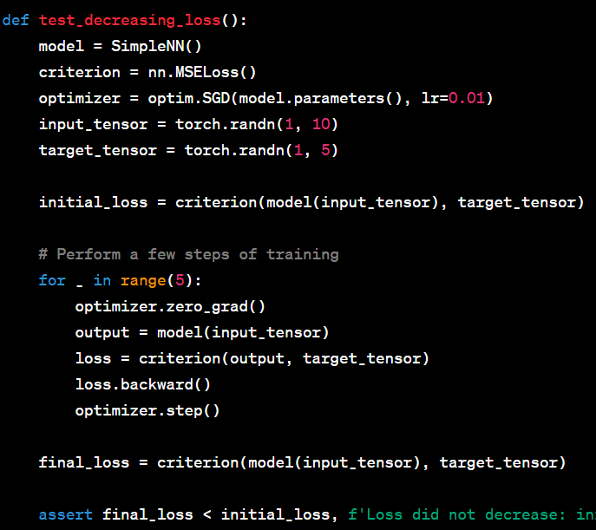
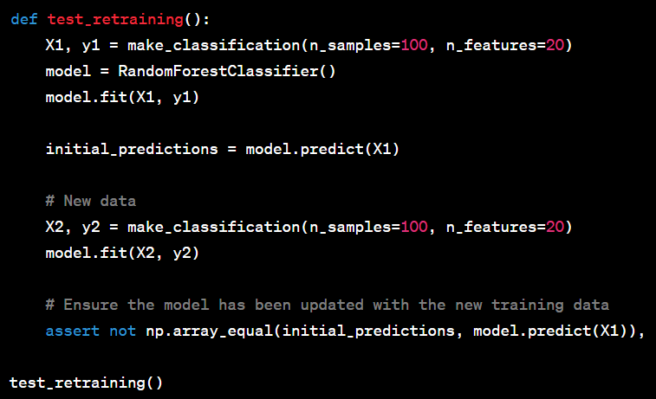
Model Testing Examples
Check for NaN predictions
Ensure correct output size:
Ensure loss decreases
Ensure the model can be retrained with other data
Notes:
Read the examples!

Slide 55
Key Concepts of Production-Level Code
Structured project repositories
Scalable and reproducible code
Clean code principles
Logging and Error Handling
Documentation and Commenting
Code Formatting and Styling
Writing good tests
Pipelines in ML projects
https://madewithml.com/
Notes:
Finaly we have pipelines! We have talked about these in the past. They are very important in ensuring the ML circle works effectively

Slide 56
Introduction to pipelines
What are pipelines?
Pipelines are concepts that assist in automating the workflow of a ML system
Why are they important
Ensure consistency
Ensure reproducibility
Ensure ease of deployment
Ensure automation
Easier troubleshooting and monitoring
Notes:
Pipelines should be views as automated sequences that streamline ML workflows! Once designed, they can automate almost everything!
Why are they important?
They ensure uniformity in the ML process!
The enable repeatable workflows, which are very crucial for validating results!
They greatly simplify the process of getting our models into production!
Most importantly they assist in automation. They reduce the number of manual interventions allowing us to save precious time and reduce errors
Finaly it makes it much easier to identify issue and track the performance of the system

Slide 57
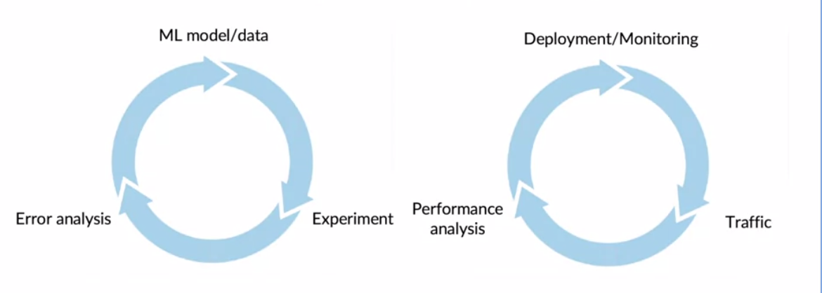
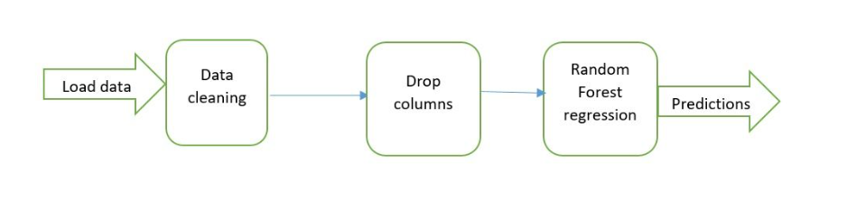
Types of Pipelines
ML workflows involve several iterative steps.
They can be time consuming (especially data cleaning and data preprocessing)
Pipelines can be viewed as sequences of steps (each handling a specific component) that automate the procedure!
The simplest pipeline:
Load data
Do data preprocessing
Split the data
Apply transformations
Make Predictions
Notes:
In general a full ML workflow as we have talked about multiple times involves several iterative steps!
When we do it manually, they can be extremely time consuming, especially when we clean and preprocess our data.
So pipelines automate this procedure to help us save time and write better code!
You can view pipelines as steps of the ML workflow being entered in the right order (Load, preprocess, train, make predictions)
Thats an example of a very simple pipeline.

Slide 58
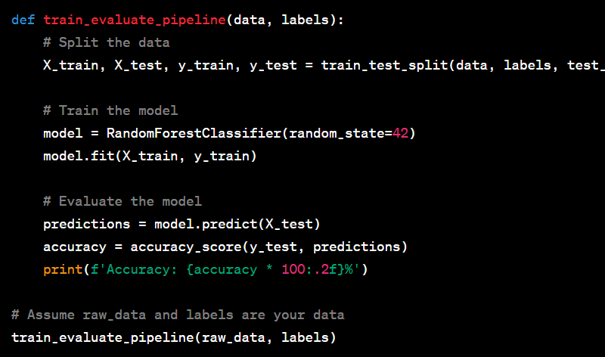
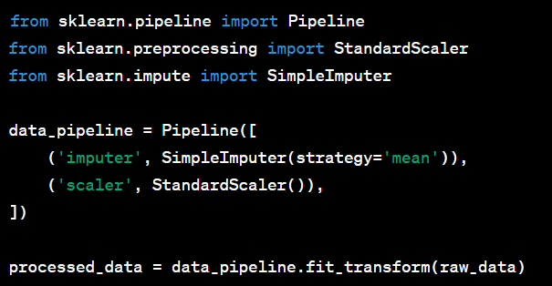
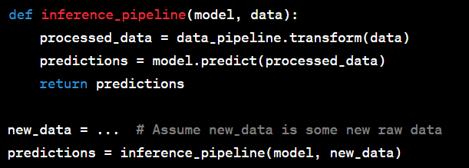
Example Pipelines
Training pipeline
Three main types of pipelines:
Data preprocessing: Load, Preprocess, clean and prepare
Training pipeline: Train and validate models
Inference pipeline: Deploy and make predictions
Data preprocessing pipeline
Inference pipeline
Notes:
We have 3 very important pipelines in ML workflows
Describe them!

Slide 59
Key Concepts of Production-Level Code
Structured project repositories
Scalable and reproducible code
Clean code principles
Logging and Error Handling
Documentation and Commenting
Code Formatting and Styling
Writing good tests
Pipelines in ML projects
https://madewithml.com/

Slide 60
Thats all for today :)

